Slide 1

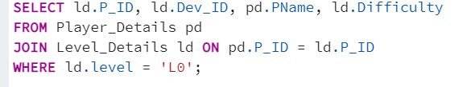
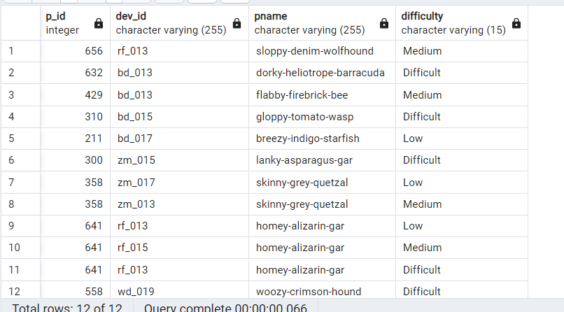
Extract `P_ID`, `Dev_ID`, `PName`, and`Difficulty_level` of all players at Level 0.
Result ==>

Slide 2
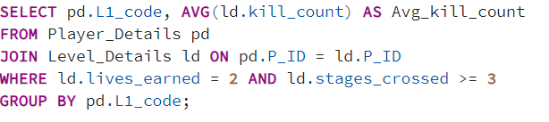
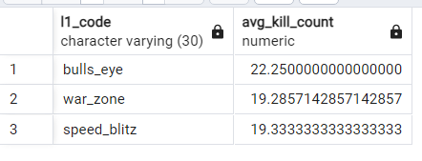
Find `Level1_code` wise average `Kill_Count`where `lives_earned` is 2, and at least 3 stages are crossed.
Result ==>

Slide 3
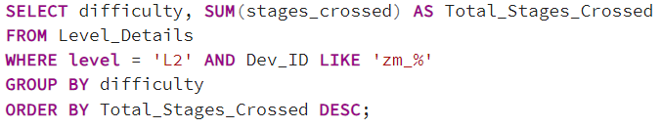
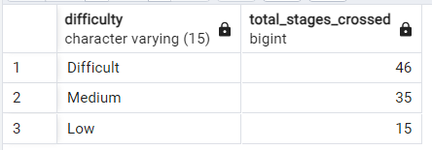
Find the total number of stages crossed at each difficulty level for Level 2 with players using `zm_series` devices. Arrange the result in decreasing order of the total number of stages crossed.
Result ==>

Slide 4
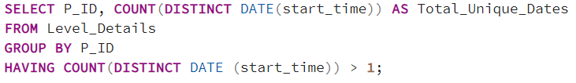
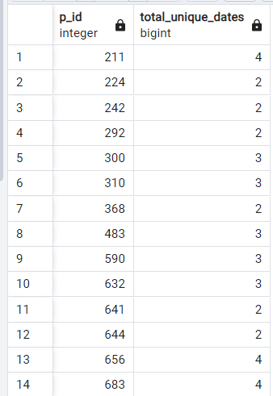
Extract `P_ID` and the total number of unique dates for those players who have played games on multiple days.
Result ==>

Slide 5
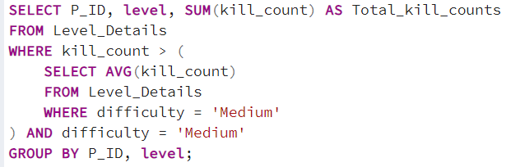
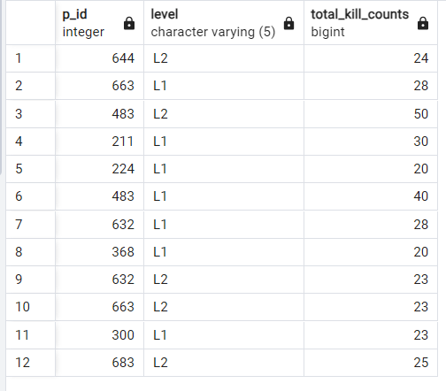
Find `P_ID` and levelwise sum of `kill_counts` where `kill_count` is greater than the average kill count for Medium difficulty.
Result ==>

Slide 6
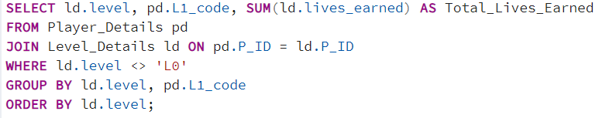
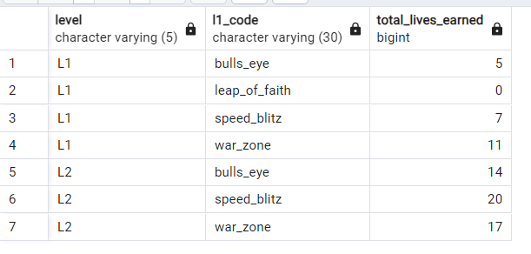
Find `Level` and its corresponding `Level_code`wise sum of lives earned, excluding Level 0. Arrange in ascending order of level.
Result ==>

Slide 7
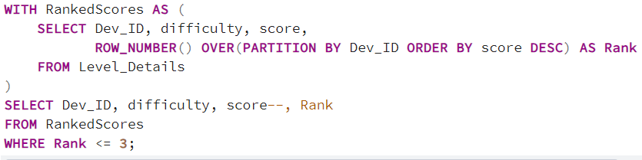
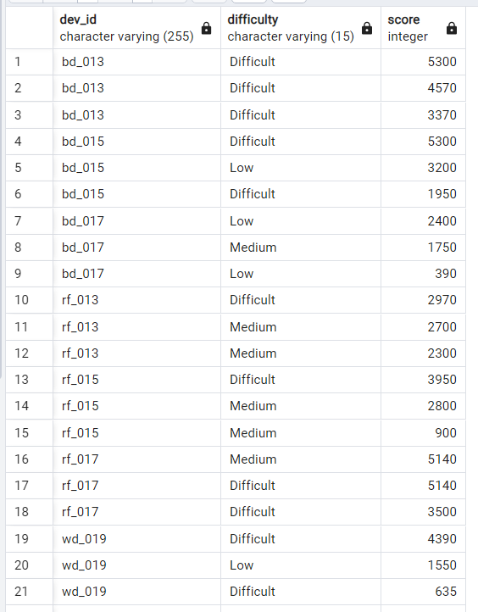
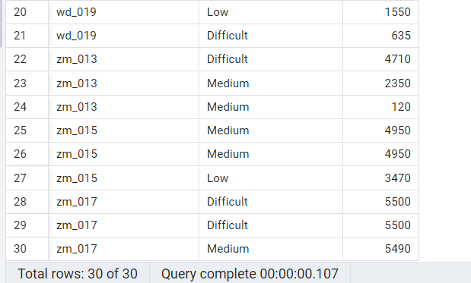
Find the top 3 scores based on each `Dev_ID` and rank them in increasing order using `Row_Number`. Display the difficulty as well.
Result ==>

Slide 8
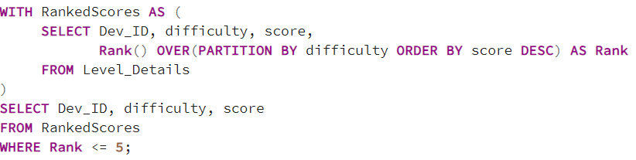
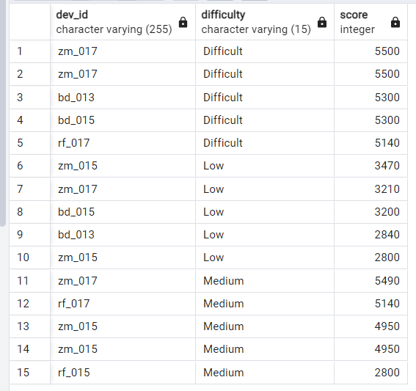
Find the top 5 scores based on each difficulty level and rank them in increasing order using `Rank`. Display `Dev_ID` as well.
Result ==>

Slide 9
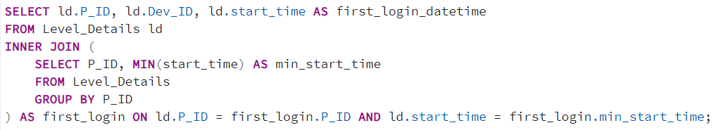
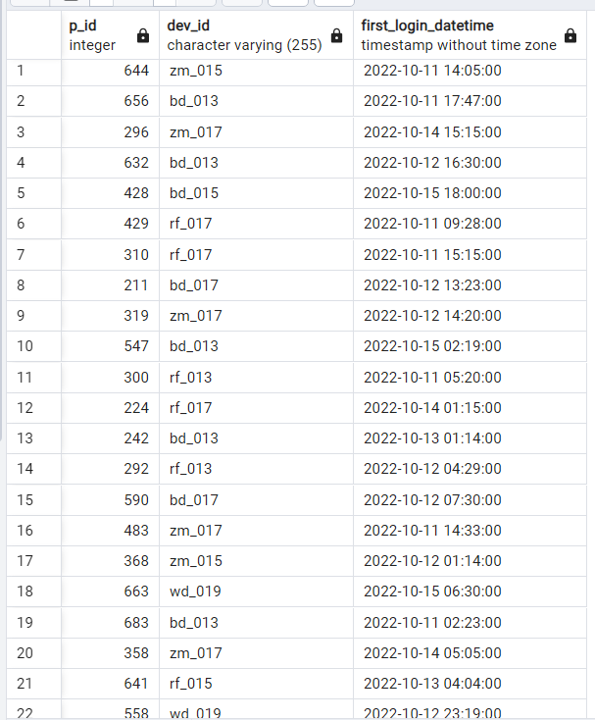
Find the device ID that is first logged in (based on `start_datetime`) for each player (`P_ID`). Output should contain player ID, device ID, and first login datetime.
Result ==>

Slide 10
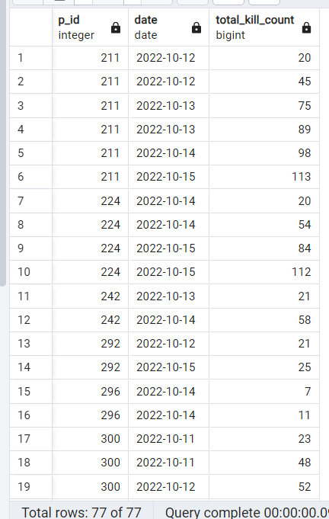
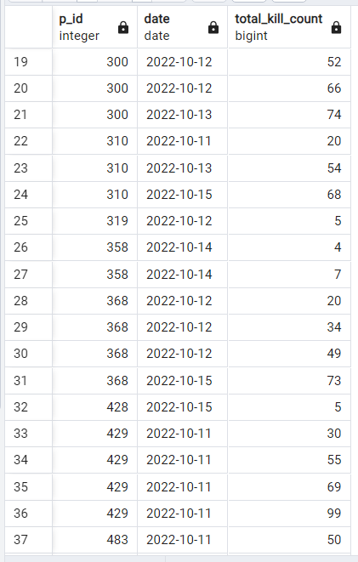
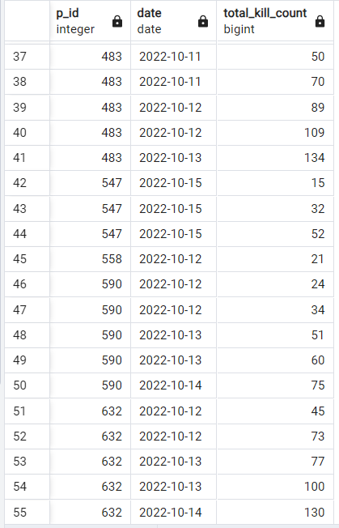
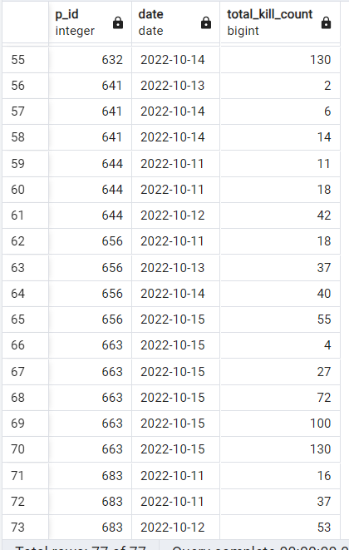
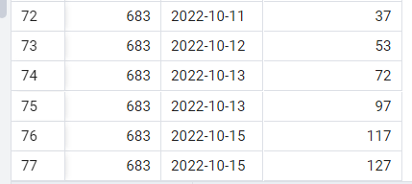
For each player and date, determine how many `kill_counts` were played by the player so far.
a) Using window functions
b) Without window functions
a) Using window functions
Result ==>

Slide 11
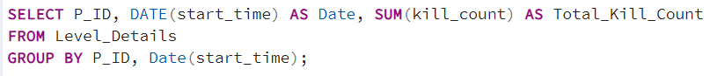
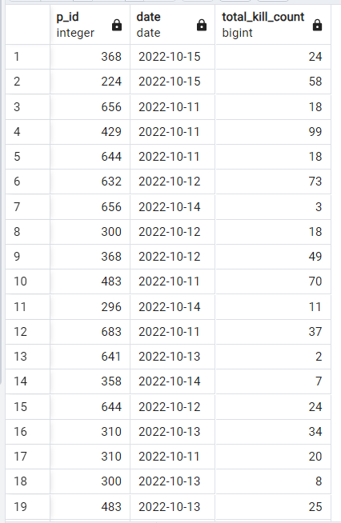
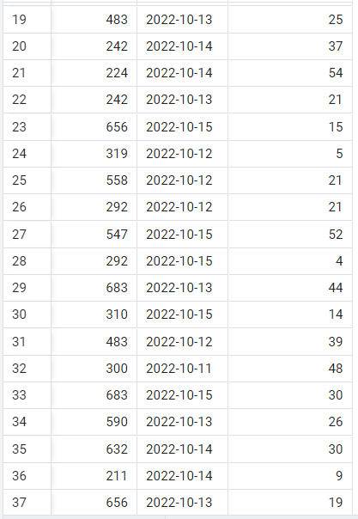
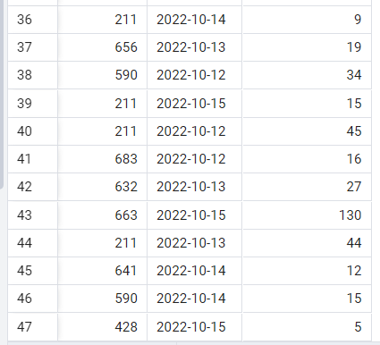
b) Without window functions
Result ==>

Slide 12
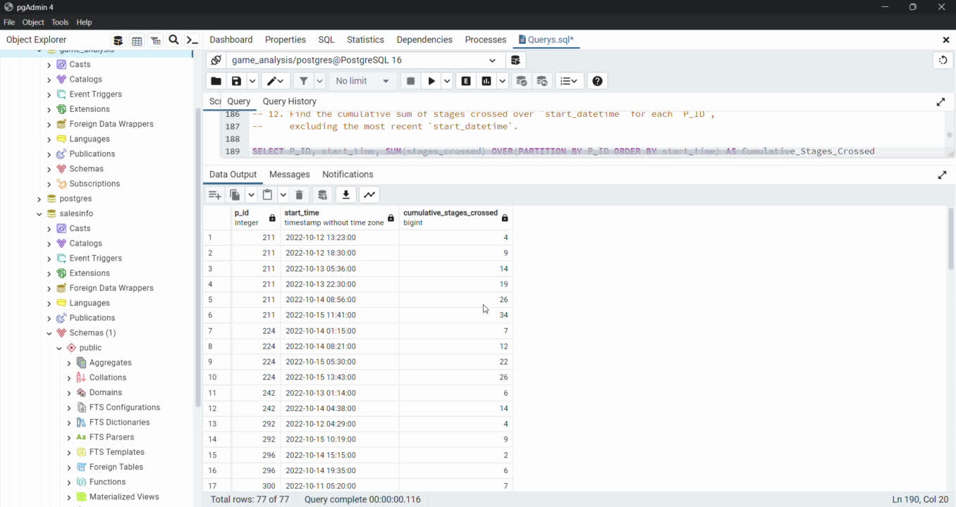
Find the cumulative sum of stages crossed over `start_datetime` for each `P_ID`, excluding the most recent `start_datetime`.
Result ==>

Slide 13
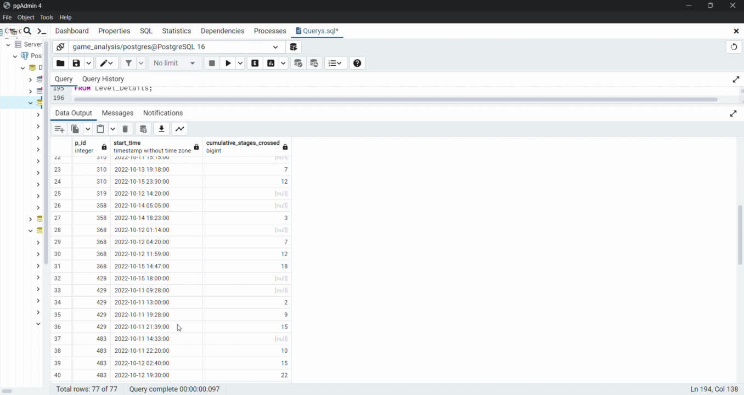
Excluding the most recent `start_datetime`:-
Result ==>

Slide 14
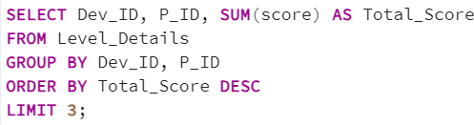
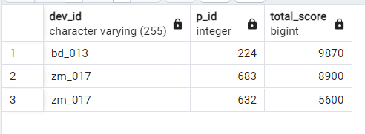
Extract the top 3 highest sums of scores for each `Dev_ID` and the corresponding `P_ID`.
Result ==>

Slide 15
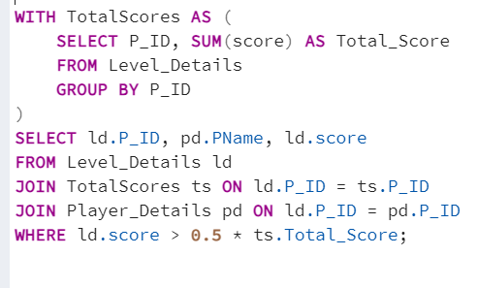
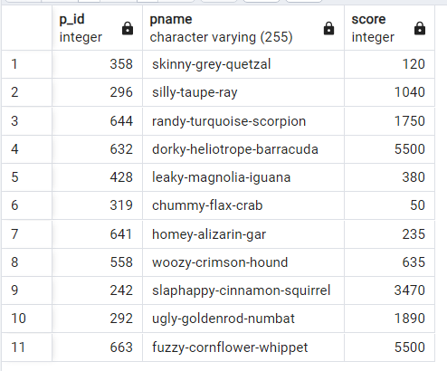
Find players who scored more than 50% of the average score, scored by the sum of scores for each `P_ID`.
Result ==>

Slide 16
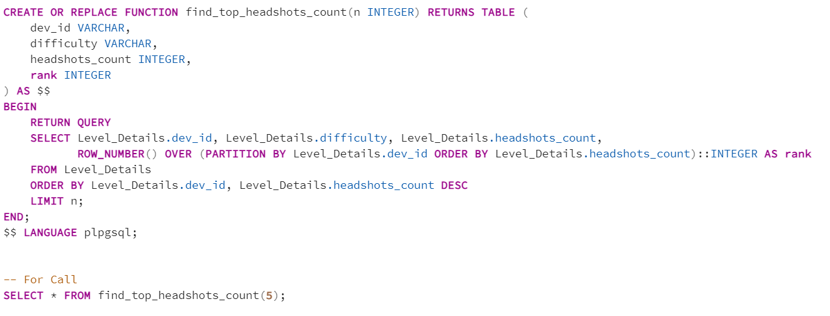
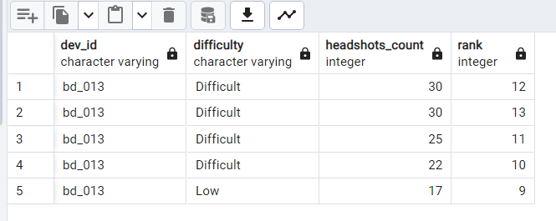
Create a stored procedure to find the top `n` `headshots_count` based on each `Dev_ID` and rank them in increasing order using `Row_Number`. Display the difficulty as well.
Result ==>

